Slide 1



Ivan Novikau
Monte Carlo

Slide 2


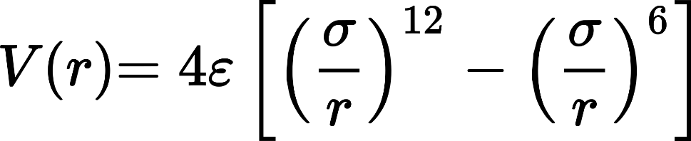
Some Facts:
100%
(ca. 500 lines of code)
Only L-J:
Three types of particles:

Slide 3
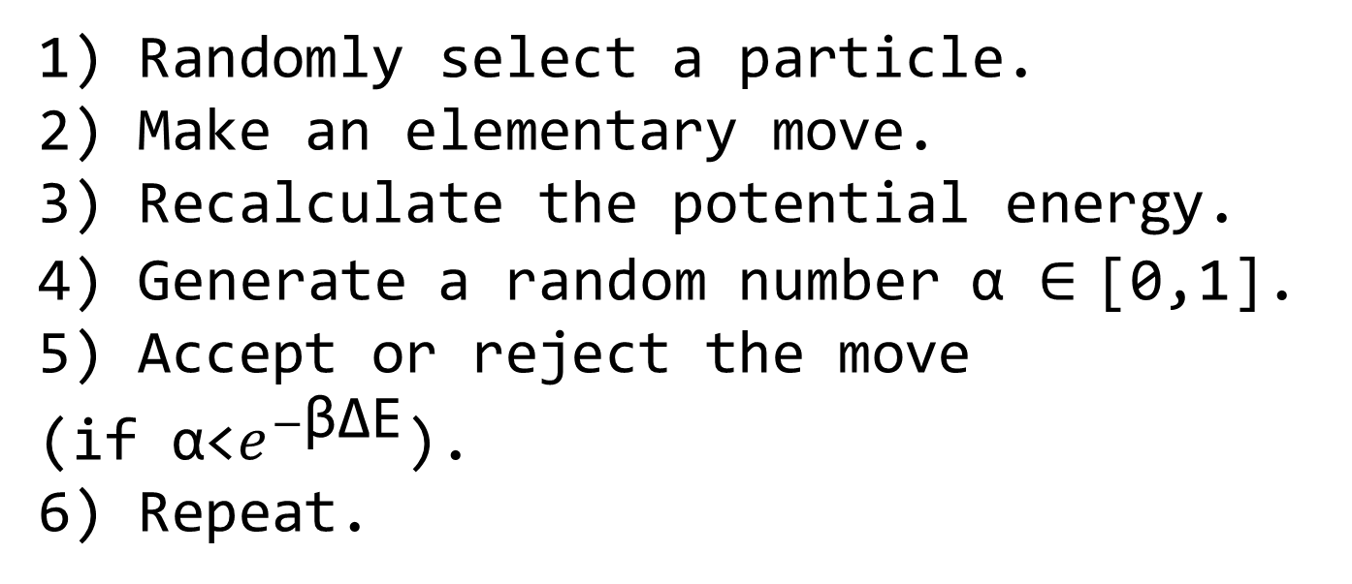
Method:
1) Randomly select a particle.
2) Make an elementary move.
3) Recalculate the potential energy.
4) Generate a random number α ∈ [0,1].
5) Accept or reject the move
(if α<$e^{−\text{βΔE}}$).
6) Repeat.

Slide 4
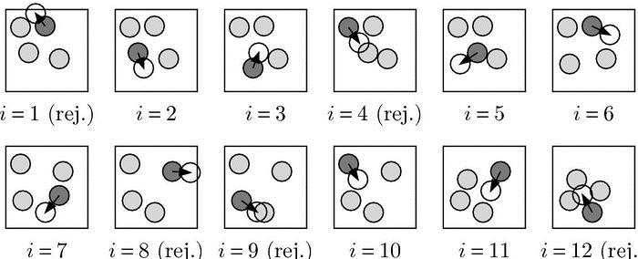
Noch einmal!

Slide 5


Initial scatter of particles
The most difficult part!

Slide 6
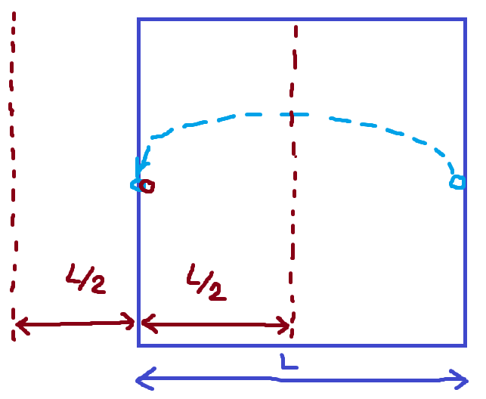


REMOVE!

Slide 7
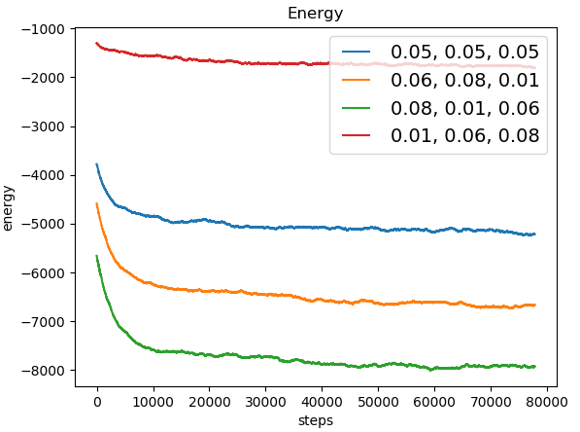

Slide 8
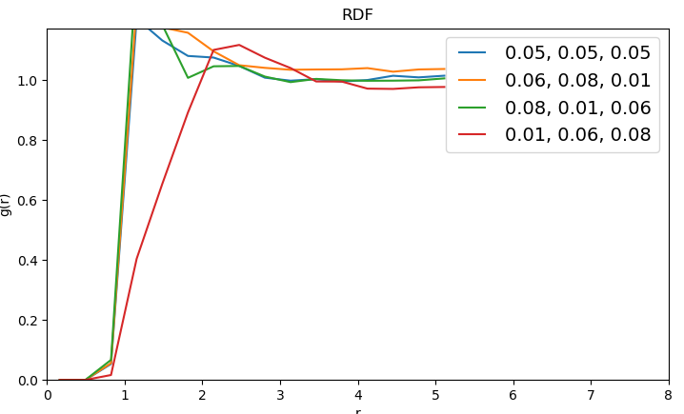

Slide 9
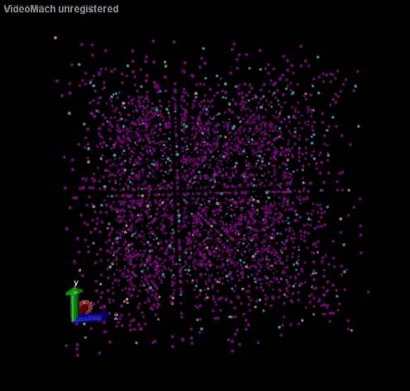

Slide 10


Vielen Dank!
https://github.com/vanadiuz/MonteCarloCCPhys2

